Slide 1

AIRBNB PRICE PREDICTION

Slide 2
BUSINESS PROBLEM
Hosts wanted to rent out their property on the Airbnb on nightly basis, but being new in the field, they are unaware of the market value of the property. As a result, they would set the price of the property as higher or least. When the price set is high in comparison to market value, he would not get any customers for renting out his property. While, on the contrary, when he will set the least price of the property, more customers would be attracted to rent out his property, but in return he will face the problem in making profits from the property.

Slide 3
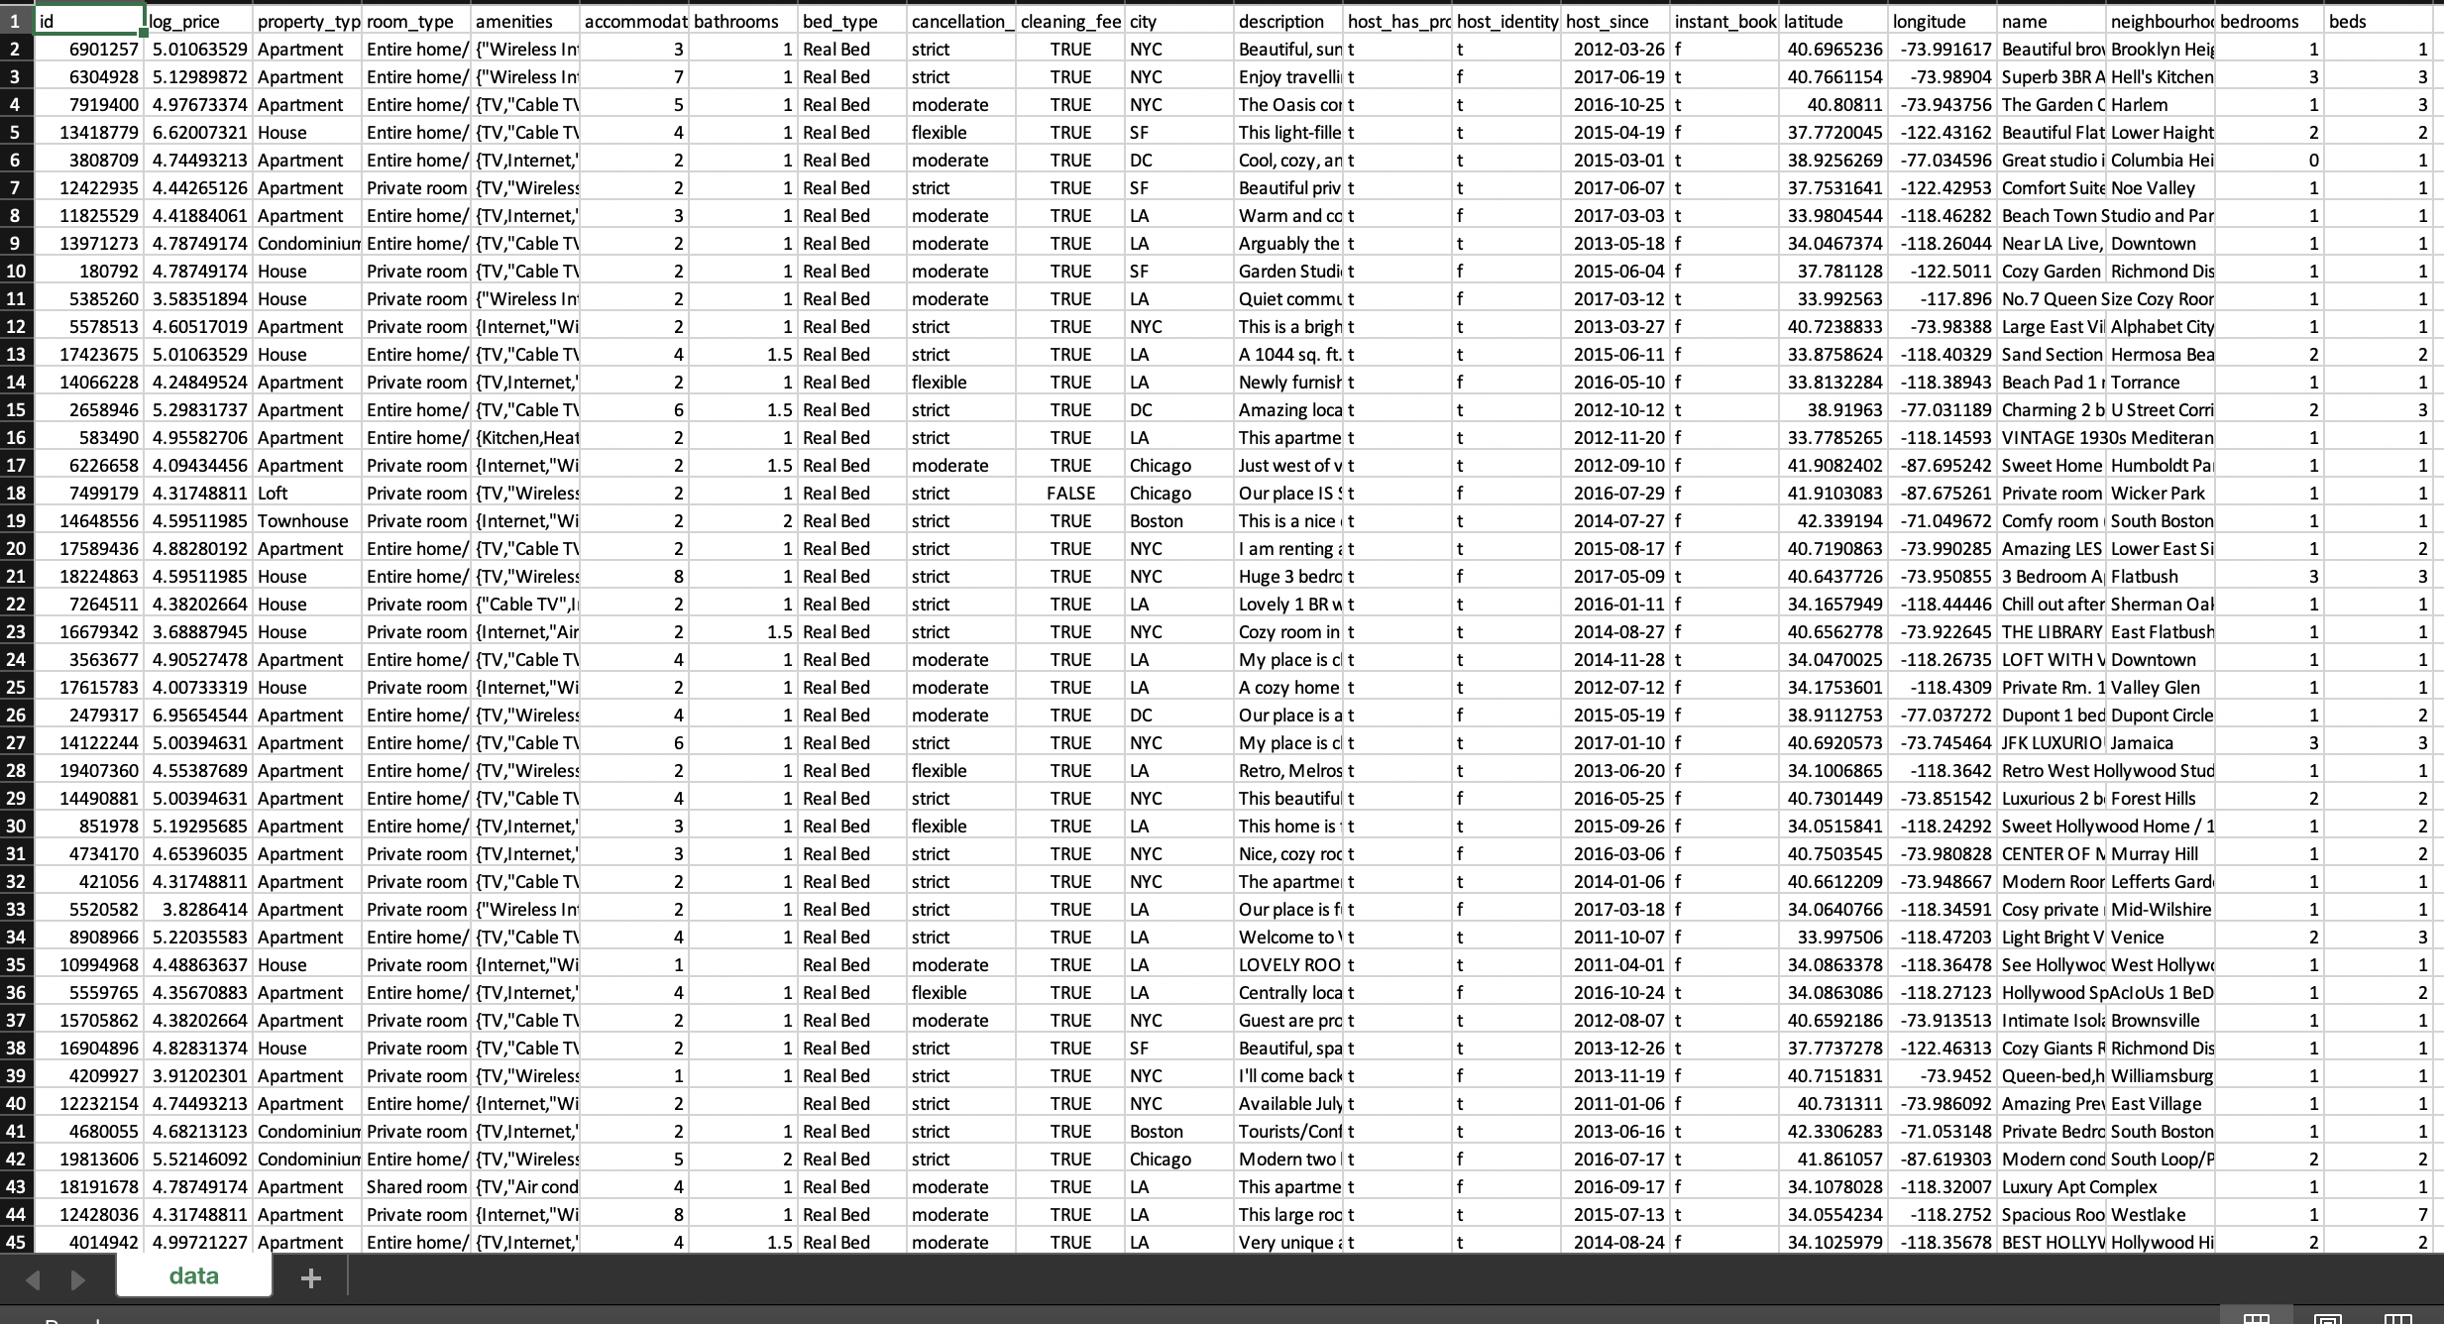
DATA SOURCE

Slide 4
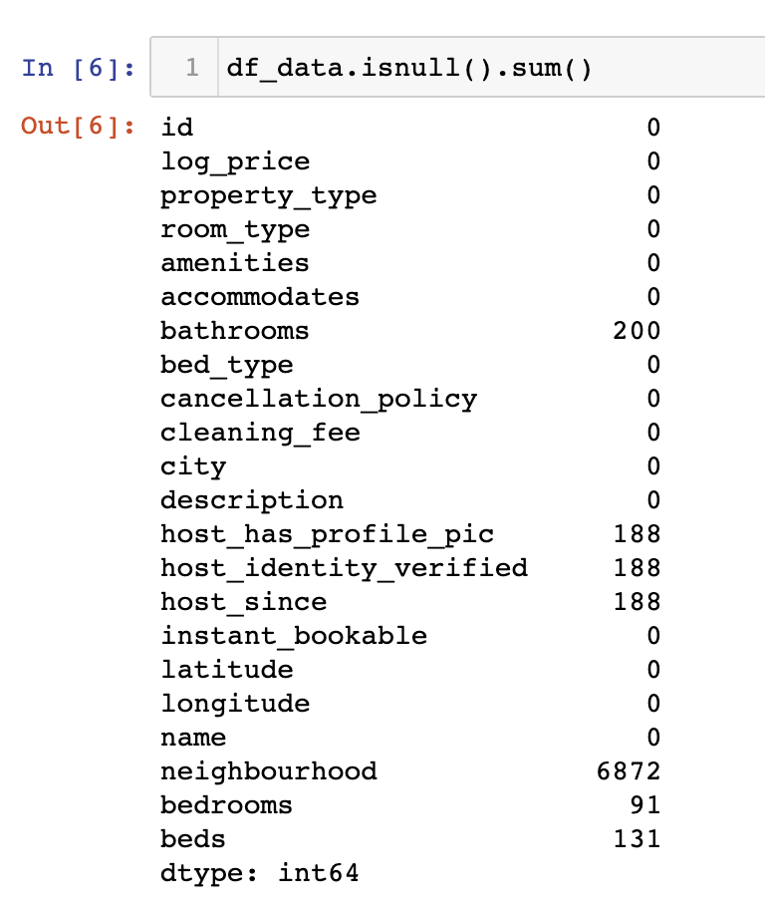
Data Acquisition and Cleansing
When data was examined it contained some missing values.
All the missing values were filled.
Once column contained more than 10% missing values, so column was removed.
Missing values were filled using the mode.

Slide 5
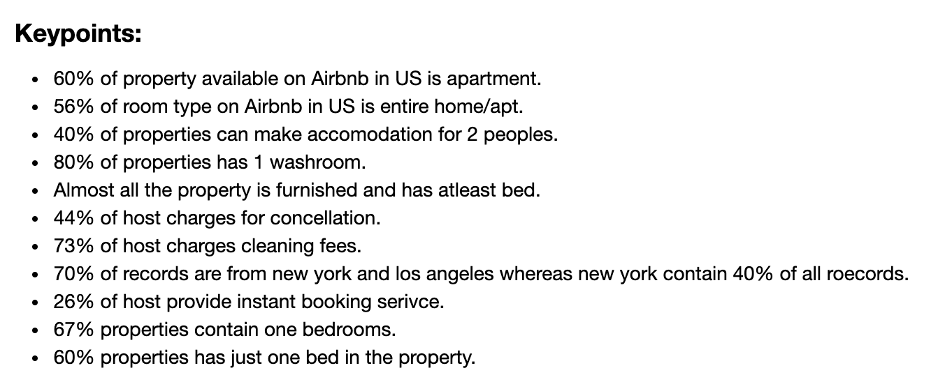
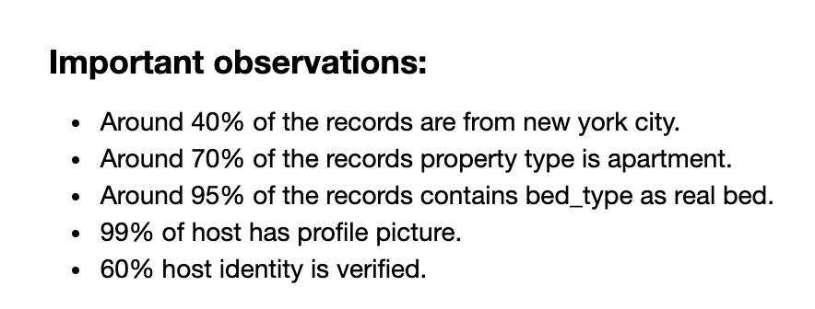
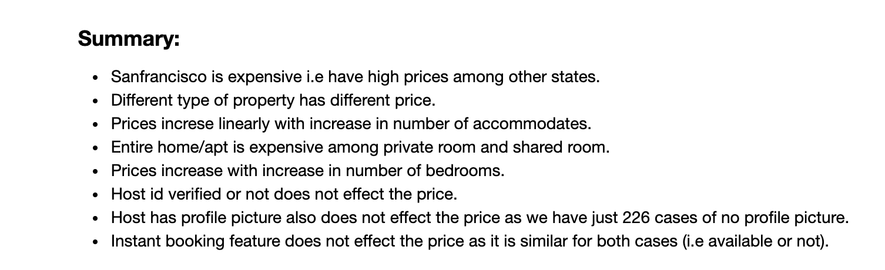
EDA and Insights
After cleaning the data
Independent features were plotted against dependent features using bar chart.
Sweetviz library was used to see visualisation.

Slide 6
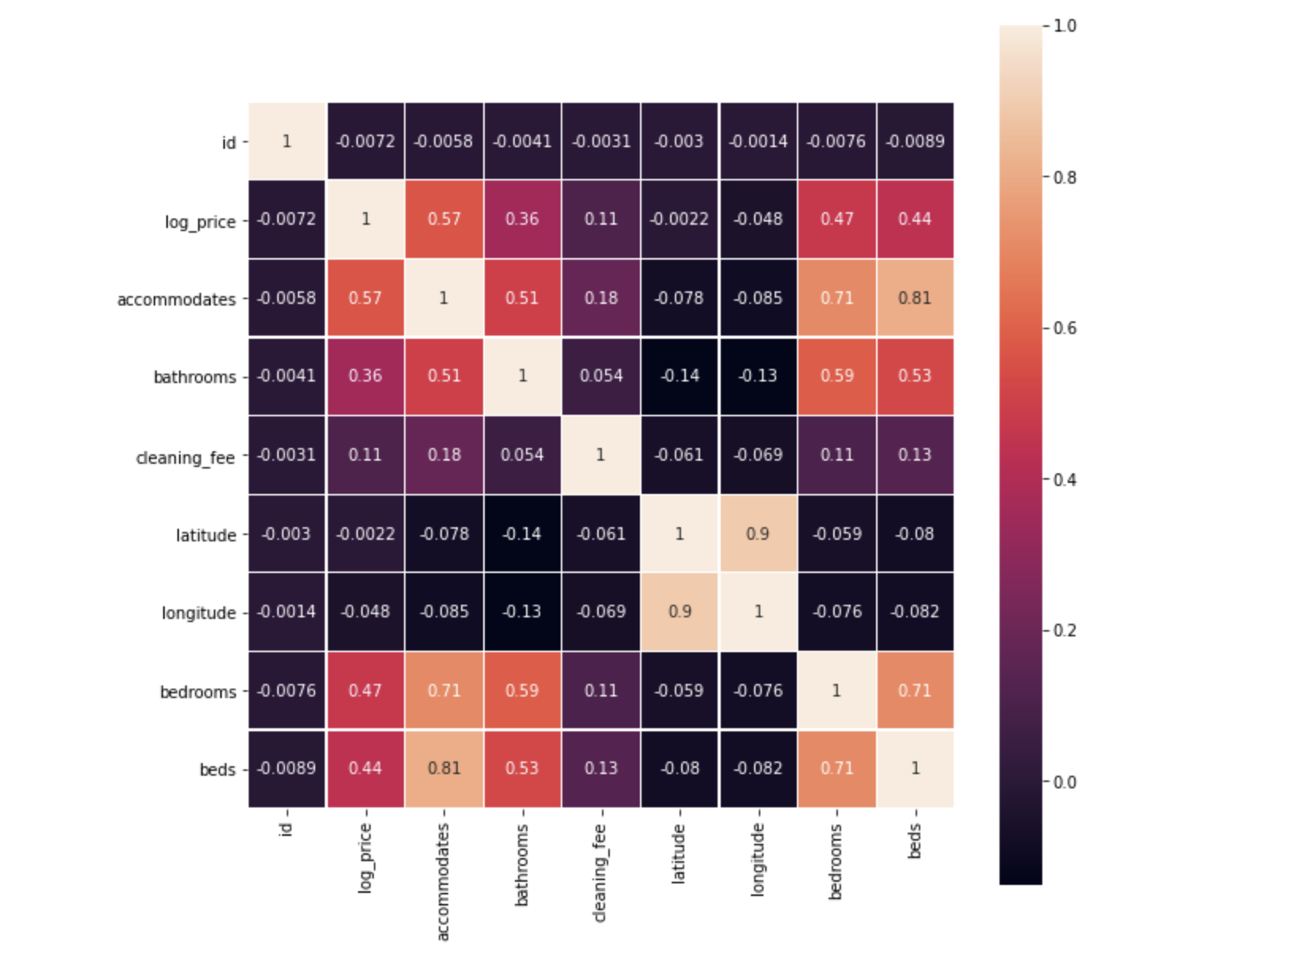
Feature Engineering
Features on which the price was not dependent were eliminated.
As two features which were highly correlated to one another, one feature was removed and one was kept.

Slide 7
ML Algorithm
The algorithm we will be using to create a model is Linear regression and Polynomial regression.
Since we need to predict the real values.
Few independent features has linear relationship with dependent variables.

Slide 8
ML Model
Three models were created using different algorithms:
Linear regression
Polynomial regression with degree 2
Polynomial regression with degree 3
Model with polynomial regression with degree 3 has highest accuracy score of 60%. So, we will discard other two models.

Slide 9
Conclusion
Model created can be used by person interested in registering their property with AirBnb to predict the price of their property. The UI can be designed and connected with the model in future so that the customer can smoothly use the model with the interactive UI.

